Slide 1
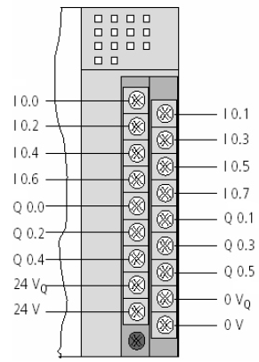
XC-CPU201-EC512K-8DI-6DO-XV
CPU
16 Entradas Digitais
16 Saidas Digitais
XIOC-16DO
IX2.0
IX2.1
IX2.2
IX2.3
IX2.4
IX2.5
IX2.6
IX2.7
XIOC-16DI
IX3.0
IX3.1
IX3.2
IX3.3
IX3.4
IX3.5
IX3.6
IX3.7
IX4.0
IX4.1
IX4.2
IX4.3
IX4.4
IX4.5
IX4.6
IX4.7
IX5.0
IX5.1
IX5.2
IX5.3
IX5.4
IX5.5
IX5.6
IX5.7
Slot 0
Slot 1
Slot 2
Slot 3
Slot 4
Slot 5

Slide 2
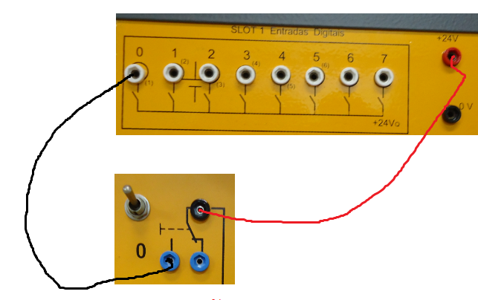
ENTRADAS DIGITAIS
Entradas disponíveis: %I.0.0 a %I.0.7

Slide 3
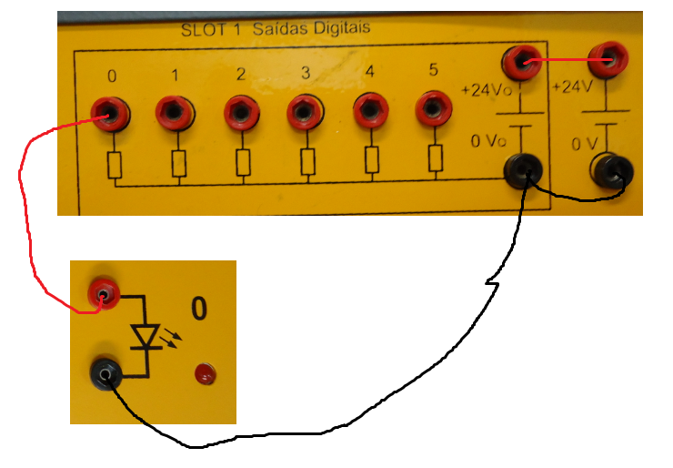
SAÍDAS DIGITAIS
Saídas disponíveis: %Q.0.0 a %Q.0.5

Slide 4
XC-CPU201-EC512K-8DI-6DO-XV
CPU
XIOC-16DO
XIOC-4AI-2AO-U1-O1
XIOC-4AI-2AO-U1-O1
XIOC-16DI

Slide 5
